Slide 1
CYBERBULLYING DETECTION
TEAM A.C.R.S
(Analysis, Classification and Research of Sentiments)-
-Sharanya Adane (220123080)
-Shubham (220103103)
-Simon Shangpliang (220101095)
-Aryan Adlakha (220101123)

Slide 2
DATA PREPROCESSING
Removal of Punctuation
Removal of Stop Words
Lowercasing of words
Removal of emojis
Removal of Links

Slide 3
Data Tokenization
Initialization of BERT Tokenizer
Analysis of Sequence Length
Padding and Truncation

Slide 4
Pre Model Training Setup
Train-Validation-Test Split
Setting Up GPU Device
Pre Training BERT
Data Loading and batching
Processing Neural Network

Slide 5
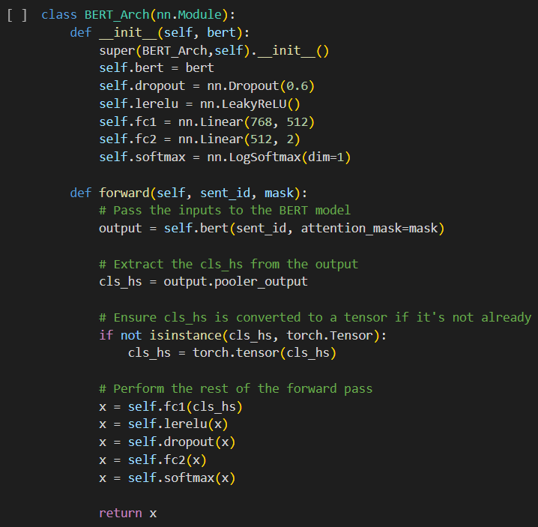
Model Architecture
Utilizing BERT for Transfer Learning
-Dropout Layer
-Activation Function: Softmax and LeakyReLU
-Hidden Layers: 2
Model Optimizer and Loss Function:
-Adam optimizer
-Cross-entropy loss

Slide 6
WHY BERT?
1. State-of-the-art performance in text classification
2. Empowered by its pre-training on extensive text data
3. BERT's bidirectional context capture makes it adept at understanding the nuanced context of cyberbullying content.

Slide 7
TRAINING PROCEDURE
Training Function
iterating over batches of training data
computing predictions
Evaluation Function
assesses the model's performance on a separate validation dataset
computes predictions on the validation data
Fine-Tuning Process
involves training the model over multiple epochs
Model trained using train function and evaluation function
calculating the loss
updating model parameters based on the loss
calculates the loss to determine how well the model generalizes
parameters are adjusted to enhance its predictive accuracy

Slide 8
THANK YOU

